Slide 1
IBM University Engagement Project Submission
“Exploring the Power of Agentic AI with IBM Granite and LangFlow”

Slide 2
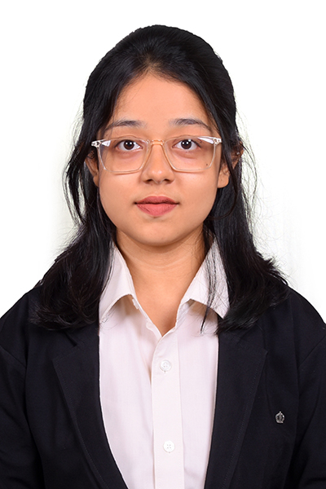
Project Tile – AI-Powered LaTeX Diagram Generator for Academic Research
Domain of Project – Education / Academics
Student Name | Recent Passport Photo | Email ID | Mobile number [WhatsApp]
Joshika Sri N R |  | joshikasri@student.tce.edu | 9025307900

Slide 3
Problem Statement -
Problem Statement : AI-Powered LaTeX Diagram Generator for Academic Research
The Challenge
Researchers and students often need professional diagrams for research papers, theses, dissertations, and technical reports. Creating TikZ diagrams manually requires extensive LaTeX knowledge, consumes significant time, and is prone to syntax errors.
Many users struggle to:
• Learn TikZ syntax
• Create publication-quality diagrams
• Modify complex diagrams
• Follow IEEE and academic formatting standards
• Generate consistent documentation-ready figures
The Objective
Develop an AI-powered agent that automatically converts natural language descriptions into publication-ready TikZ diagrams.
The solution should:
• Convert plain English descriptions to TikZ code
• Generate professional academic diagrams
• Support iterative refinement
• Produce compilable LaTeX output
• Generate figure captions automatically
• Improve research productivity

Slide 4
Technology Used
Tech Stack (Mandatory)
Use any one of the following approaches:
IBM watsonx Orchestrate + IBM watsonx.ai + Granite Models
I used IBM watsonx Orchestrate + IBM watsonx.ai + Granite Models

Slide 5
Proposed Solution -
Proposed Solution: AI-Powered LaTeX Diagram Generator Agent
The proposed solution is an intelligent AI agent capable of generating professional TikZ diagrams from natural language descriptions. The system enables researchers, students, and academicians to generate publication-ready TikZ diagrams directly from natural language descriptions, eliminating the need for manual TikZ programming.
The workflow begins when a user describes a diagram in plain English, such as a research workflow, system architecture, UML diagram, neural network architecture, flowchart, or decision tree. The IBM Granite model analyzes the request, identifies key components and their relationships, and constructs an internal diagram representation.
The Agentic AI engine then performs diagram validation by checking for missing nodes, disconnected relationships, ambiguous structures, inconsistent naming conventions, and layout issues. Based on this analysis, the system generates optimized TikZ code following academic publication standards.
Beyond code generation, the solution automatically creates: • Figure captions suitable for research papers • LaTeX figure environments ready for direct insertion • Accessibility descriptions for documentation • Component-wise explanations of the generated diagram • Suggestions for improving clarity and readability

Slide 6
IBM Watsonx Orchestrate component Used -
1) Chat Input –Accepts natural language diagram descriptions.
2) IBM Granite Model - Processes requests and generates diagram logic.
3) Name of IBM Granite model -GPT-OSS-120B / Granite Model available in watsonx Orchestrate
.
4) Chat output - Displays generated TikZ code and explanations.
5) Optional Knowledge Base - Stores TikZ documentation and academic formatting guidelines.
6) IBM Watsonx AI Agent - Controls generation, validation, and refinement.

Slide 7
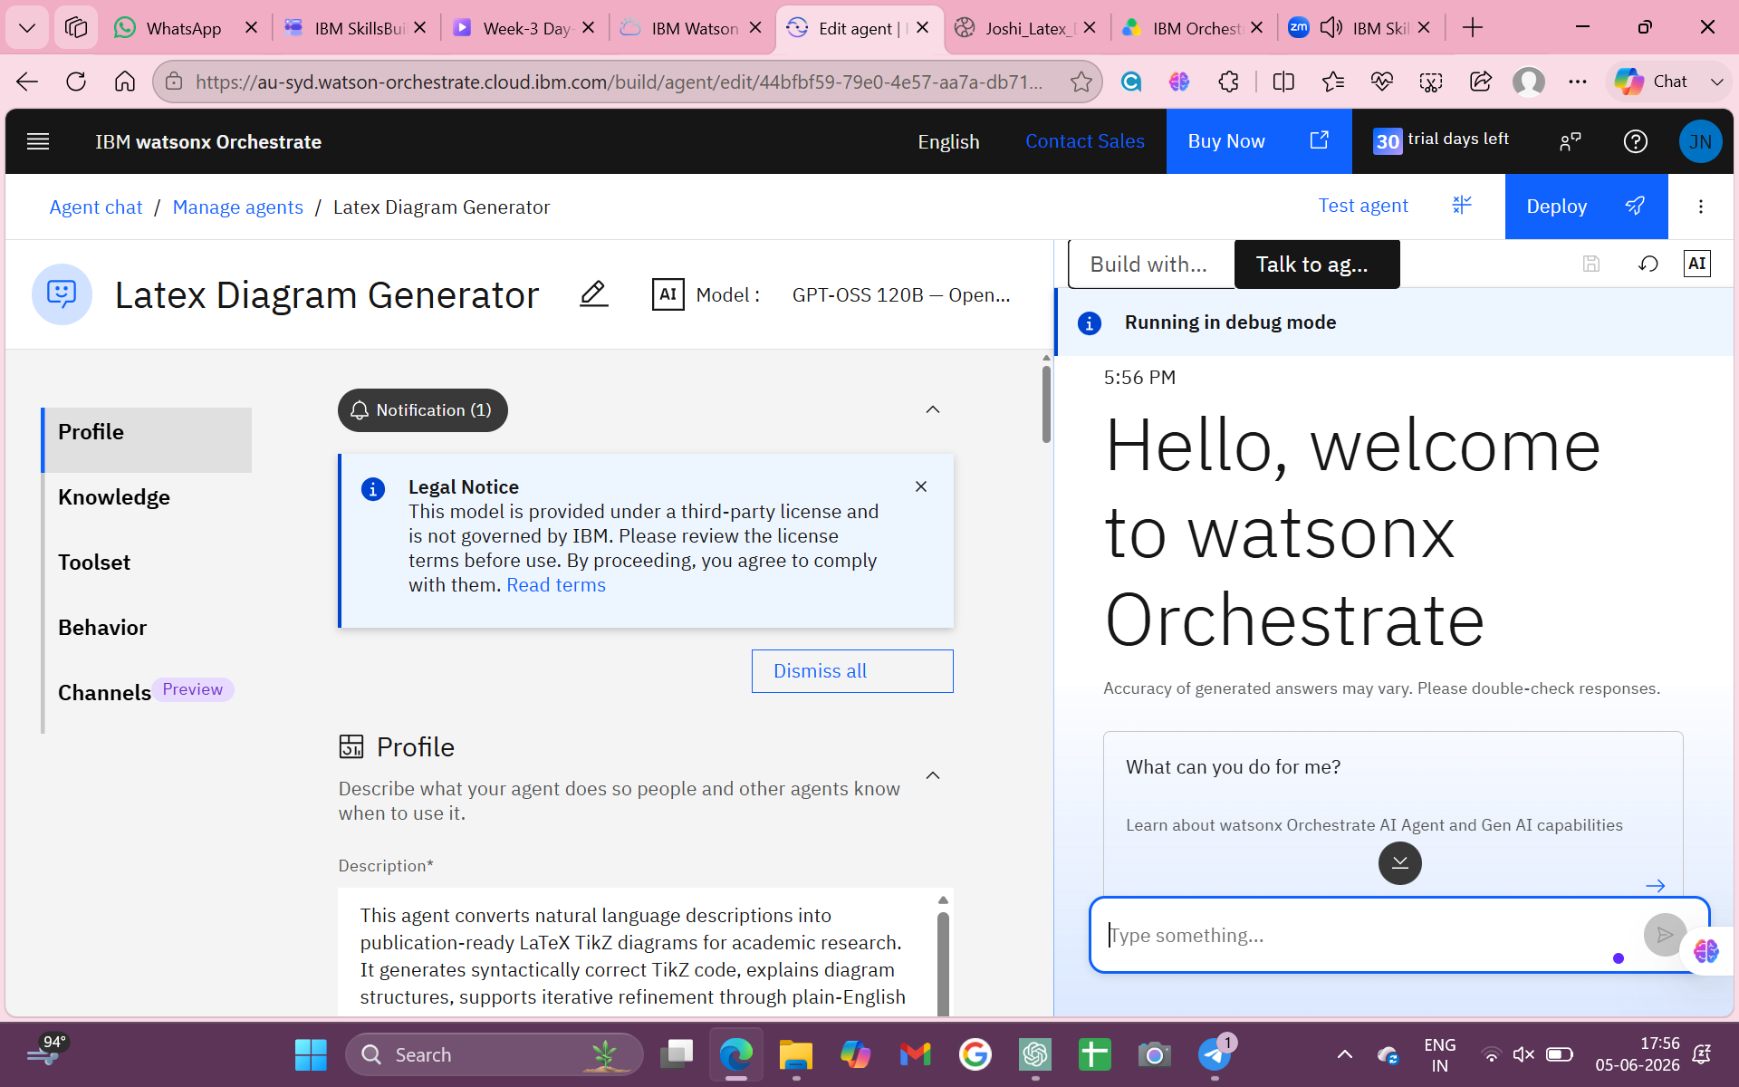

Screenshots

Slide 8
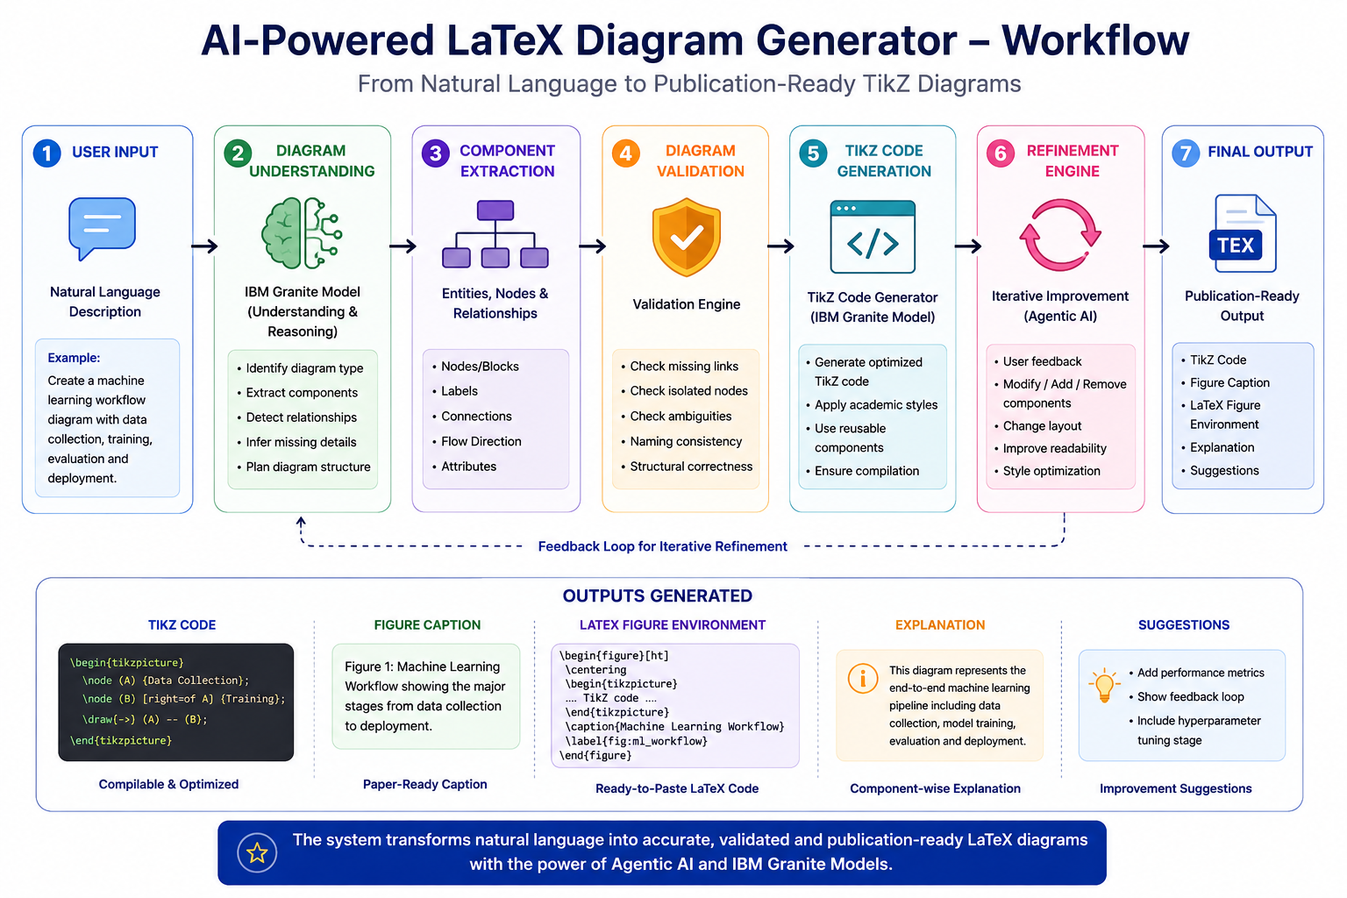
Architecture blueprint

Slide 9

Role of Agentic AI in the solution
Agentic AI enables autonomous decision-making during Latex diagram generation.
The agent:
• Understands user intent
• Identifies diagram structures
• Selects suitable layouts
• Validates relationships
• Generates complete TikZ code
• Suggests improvements
• Supports iterative refinement
This transforms the system from a simple code generator into an intelligent academic assistant.

Slide 10
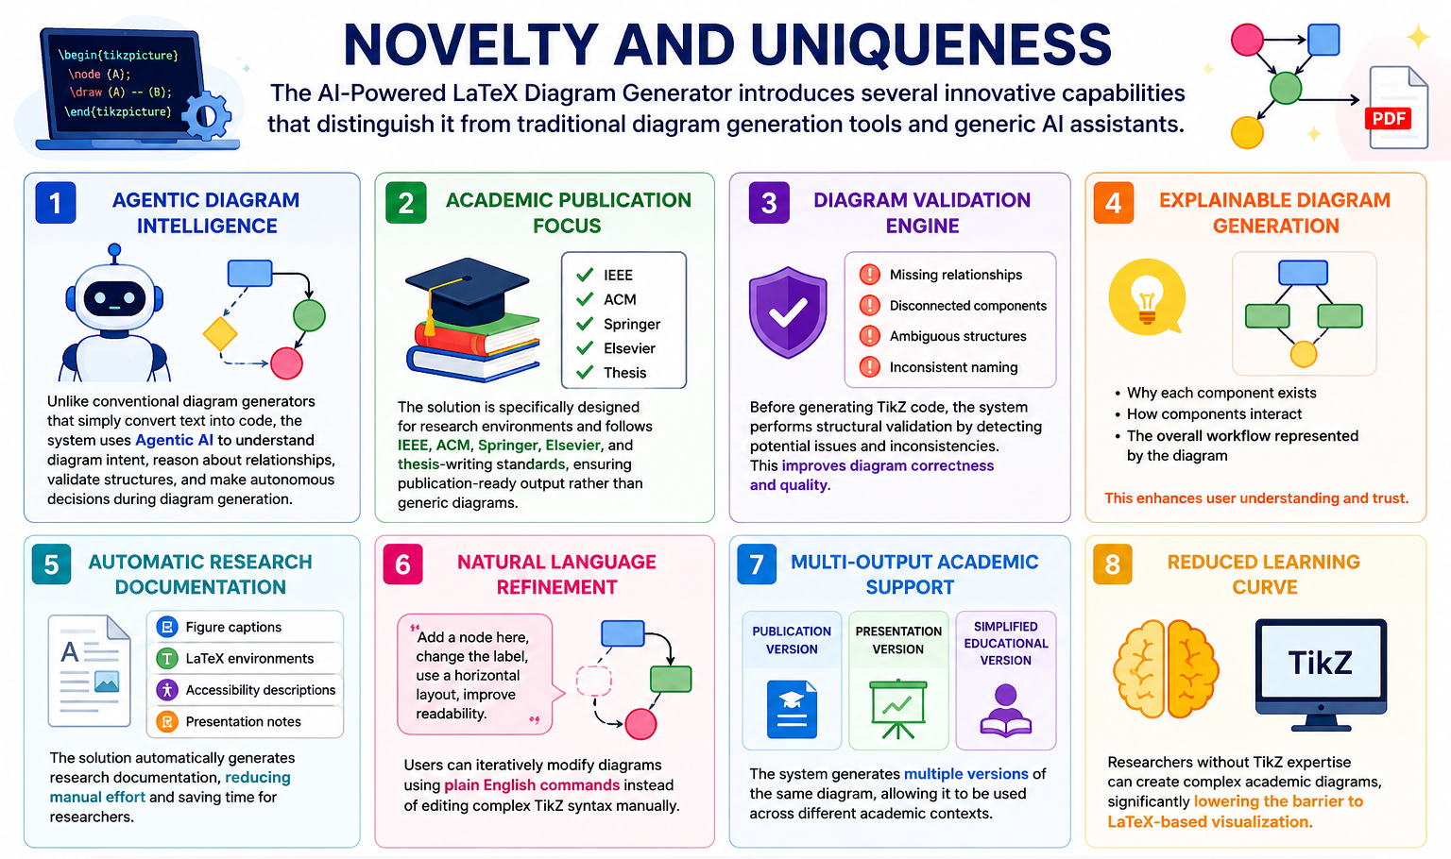
Novelty and Uniqueness

Slide 11
Git Hub Link
Github URL – joshika-sri/Joshika-Sri-N-R_IBM-SkillsBuild_AICTE-Repository
·
·
·

Slide 12
Future Scope
1. Agentic AI-Powered Diagram Intelligence
Understands diagram intent, relationships, and structure before generating TikZ code.
Publication-Ready Academic Diagrams
Produces IEEE, ACM, Springer, and thesis-compliant diagram layouts.
Automatic Diagram Validation
Detects missing nodes, disconnected components, and structural inconsistencies.
Natural Language Refinement
Allows users to modify diagrams using simple English commands instead of TikZ syntax.
End-to-End Research Documentation
Automatically generates TikZ code, figure captions, LaTeX environments, and diagram explanations.
These are concise, meaningful, and sound much stronger to evaluators than generic AI features.
·
·

Slide 13


